Slide 1
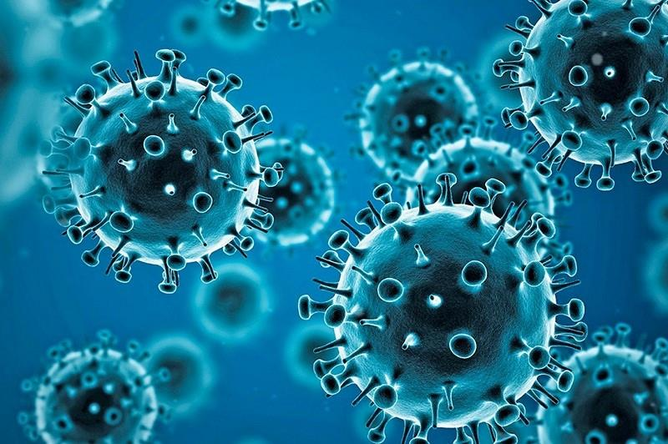
Nigeria COVID-19 Data Analysis using Python
By
Harrison Osiezagha
Ustacky Capstone Project

Slide 2
INTRODUCTION
Coronavirus disease (COVID-19) is an infectious disease caused by a newly discovered coronavirus, and it has affected major parts of the world. Nigeria, a West-African country, has also been affected by the COVID-19 pandemic after recording its first case on 27th February 2020.
Nigeria is a country with 37 states - Federal Capital Territory included- and a fast-growing economic environment with about 200 million citizens. COVID-19 has affected several country activities as the country steadily progressed from its first case to shutting down major airports, statewide lockdown, curfews, and reviving its economy.
This project is aimed at employing data science & analytics skills to collect data, explore the data, perform analysis, create visualizations, and generate insights on the effect of the virus on the country.
This analysis shows:
The South-West geopolitical region of the country is most affected by the virus,
The negative effect of the virus on the Gross Domestic Product (GDP),
The relationship between the Vulnerability index (CCVI Index) and the number of confirmed cases,
The top states with the most confirmed cases of the virus and casualty,
The relationship between the confirmed cases in each state and the population,
The daily infection, recovery and casualty rate of cases in the country.
Vaccinations count in Nigeria as at 2022-03-27

Slide 3
DATA OVERVIEW & METHOD 1/2
The data for this analysis was sourced from different location and combined to perform analysis and provide insights.
The data sources include:
1. The Nigeria Centre for Diseases Control (NCDC) monitors the country’s COVID-19 situation, and releases data on metrics across all the 37 states in the country. From NCDC COVID-19 official website, you will obtain the data by performing a web extraction or web scraping.
2. The Johns Hopkins University Center for Systems Science and Engineering (JHU CSSE) publishes daily data on confirmed, death and recovered cases across different countries. You will access the daily data for Nigeria from their repository and derive related insights. Steps on how to do this will be provided in the starter code.
3. Nigeria Community Vulnerability Index data
The vulnerability index was computed by considering several factors such as socio-economic status, population density, housing type, transportation, epidemiological, health system etc, these factors are known as themes. Each theme was broken into subthemes, and data was gathered from them to compute the overall vulnerability index score by weighing equally each theme. You can use the index data with datasets related to the pandemic such cases, deaths etc to determine relationships and correlations in your analysis.
Note that:
- The term “vulnerability” refers to the impact of the virus on a community after the virus arrives.
- It ranks from Very Low(0) to Very High(1+)
Refer to the Data Dictionary for more information.
Resource Link - Click Here

Slide 4
DATA OVERVIEW & METHOD 2/2
4. Real Domestic Gross Product Data
We have provided data on the Real Domestic Gross Product(GDP) data for Nigeria. This will help you determine the impact of COVID-19 on the economy. You can achieve this by comparing the Real GDP(Pre-COVID-19) with Real GDP(During COVID-19).
- Read more https://www.aljazeera.com/news/2020/11/21/nigeria-slips-into-recession-blamed-on-covid-19-and-oil-prices
- https://www.pwc.com/ng/en/assets/pdf/economic-alert-october-2020.pdf
5. State Budget Data
States across the country reduced their initial budget due to the impact of COVID-19 on the economy. We have provided you with data on this, and you can also use this to determine the impact of COVID-19 on the economy.
6. WHO Coronavirus (COVID-19) Dashboard
The WHO coronavirus (COVID-19) dashboard presents official daily counts of COVID-19 cases, deaths and vaccine utilisation reported by countries, territories and areas. Through this dashboard, we aim to provide a frequently updated data visualization, data dissemination and data exploration resource, while linking users to other useful and informative resources.
Download link: https://covid19.who.int/WHO-COVID-19-global-data.csv
Download link: https://covid19.who.int/WHO-COVID-19-global-table-data.csv
Download links: https://covid19.who.int/who-data/vaccination-data.csv
Download link: https://covid19.who.int/who-data/vaccination-metadata.csv

Slide 5
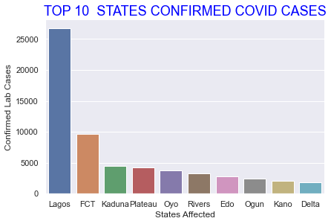
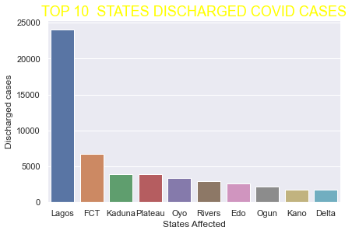
ANALYSIS & RESULTS
Fig 1-3 - Plots of Top 10 States Confirmed, Discharged/Recovered cases COVID-19 cases in Nigeria.
Fig. 1-3 shows Lagos State has the highest cases of COVID-19 confirmed, discharged and death cases, recording 26,708 confirmed cases, 24,037 discharged and 236 death cases respectively as at 1st March, 2022.

Slide 6
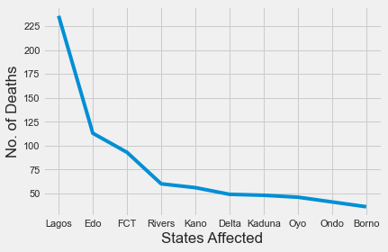
Plot showing Lagos having the highest count of death.

Slide 7
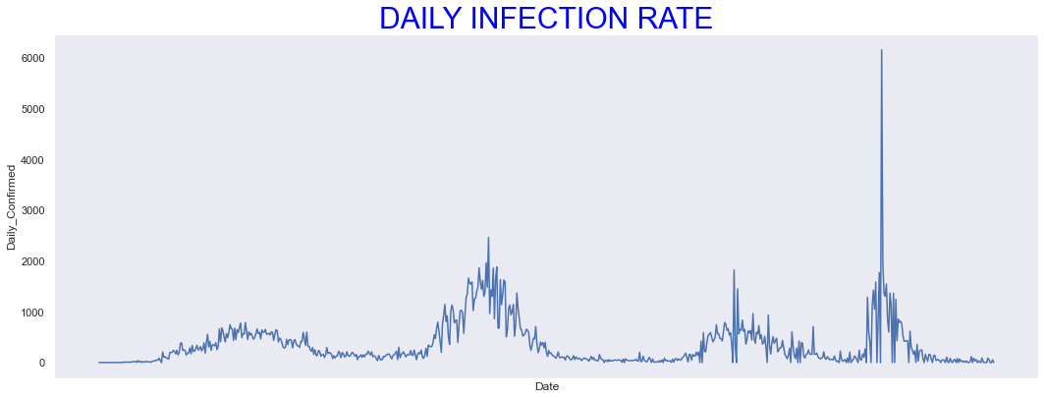
Fig. 4 shows the daily infection rate of the virus from 28th February, 2020 till date. The chart shows two waves of the virus, first being early 2020 and the second bigger wave towards the end of the year.

Slide 8
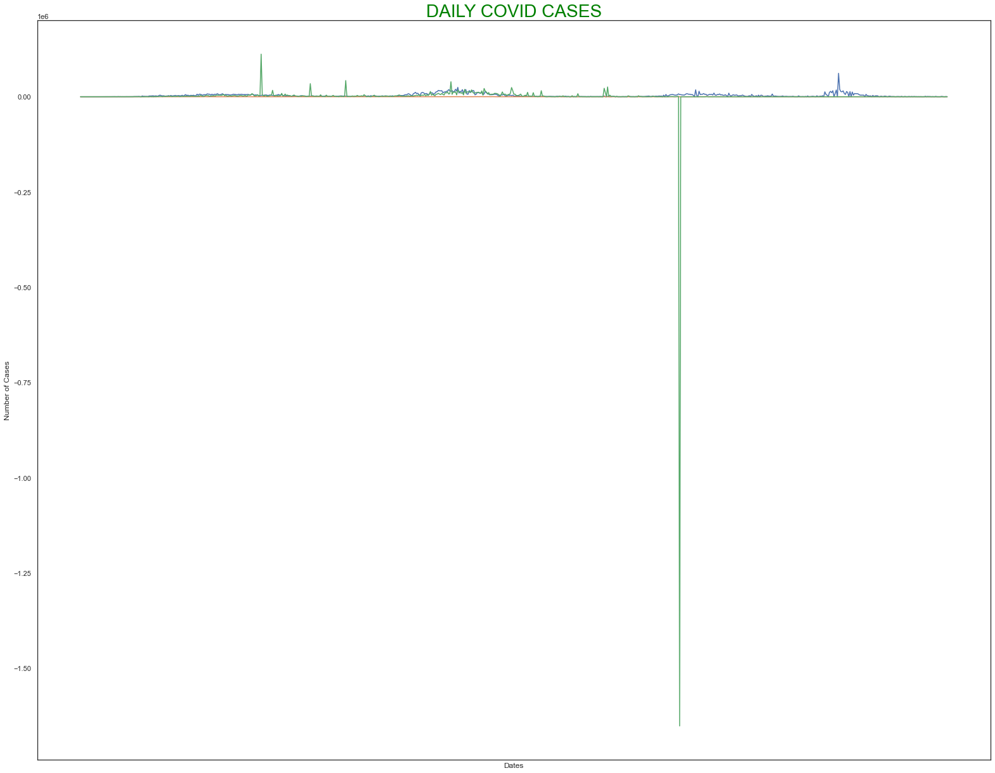
Fig. 5 Shows a combination of COVID-19 cases of Confirmed, recovered and death cases. The major spike in the recovery cases and insignificant exponential growth of death cases shows an effective approach towards the treatment /preventive measures of transmitting the virus.

Slide 9
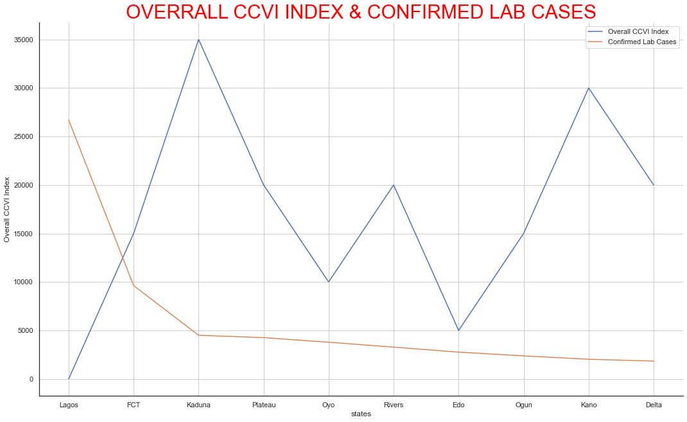
Fig. 6 Shows the relationship between the overall CCVI Index (Vulnerability Index) and the number of confirmed cases of COVID-19 in the top 10 infected states in Nigeria. The vulnerability index is a measure of how susceptible a state is to the virus (see Data Overview). The plots show no direct relationship between CCVI Index and the number of confirmed cases in each state. Lagos States, which has the highest number of confirmed cases (26,708.0) of the virus has a CCVI Index of 0.0. Kaduna and Kano state with a CCVI Index of 0.7 and 0.6 respectively, which should be more susceptible to the virus and hence, have more cases, both have less than 5,000 cases each.

Slide 10
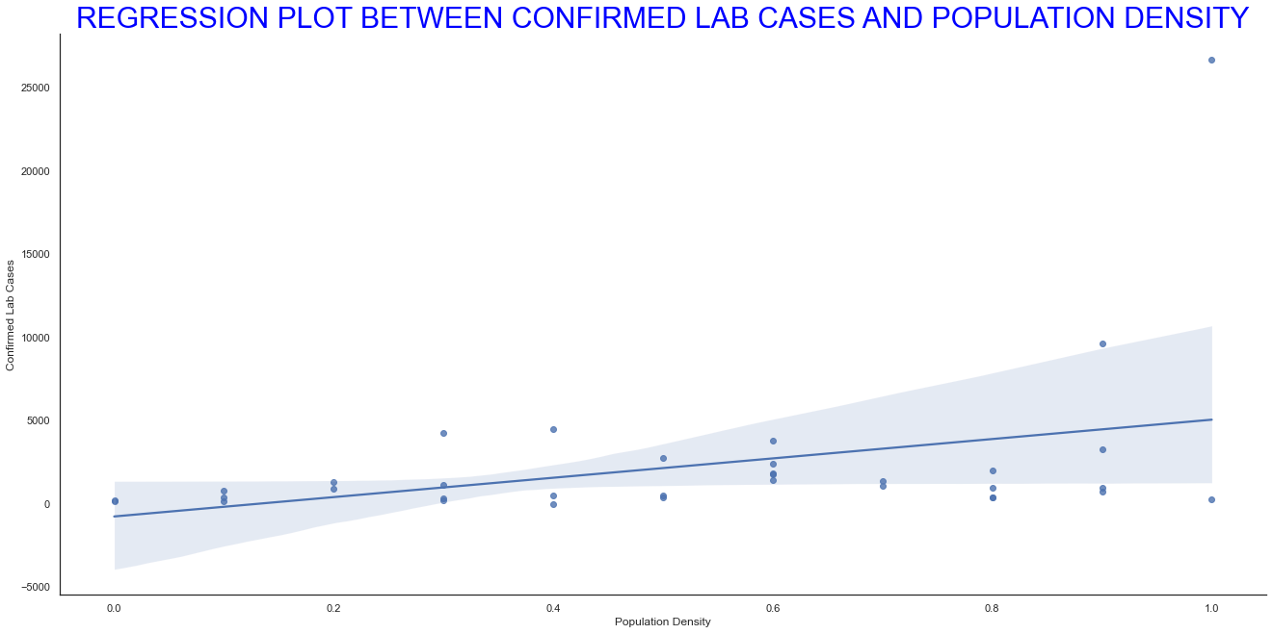
Fig. 7 Shows the regression plot between the number of confirmed cases and population density of each states.

Slide 11
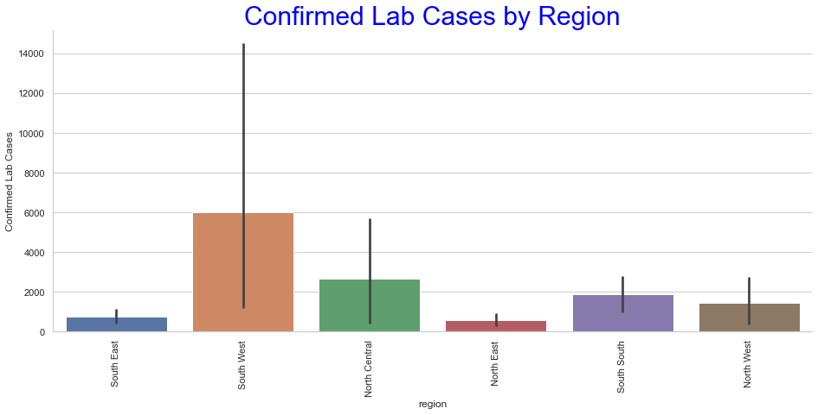
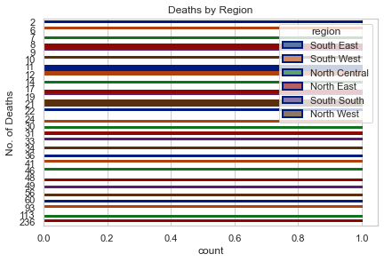
Fig. 9 Nigeria is divided into six geopolitical regions. This shows the number of confirmed cases of COVID-19 by Region in Nigeria. South-West Region has the highest number of confirmed cases which includes states like; Lagos, Oyo, Ondo, Ogun, etc. followed by North Central which includes states like FCT, Kogi, Plateau, etc.
Fig 10 Shows deaths per region in Nigeria, with South-West having the highest cases.

Slide 12
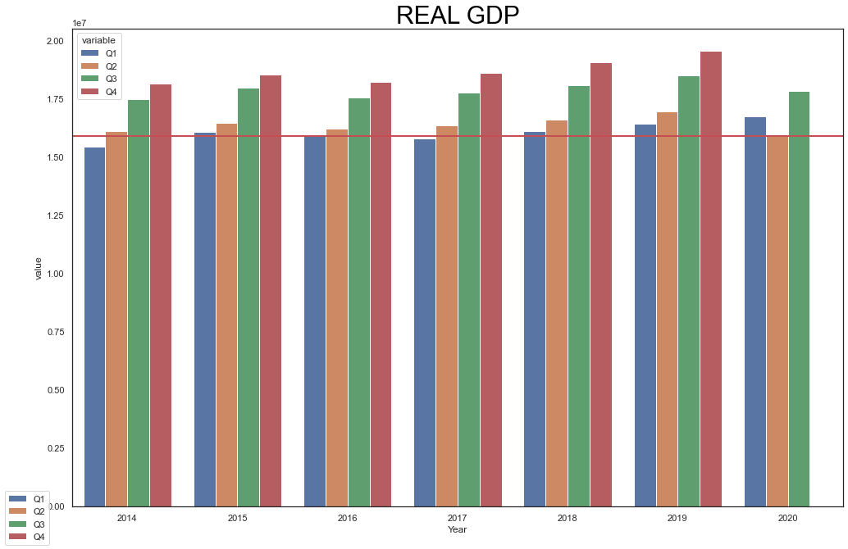
Fig. 11 Shows the Gross Domestic Product of the country between 2014 – 2020. This shows Q2 of 2020 has the lowest GDP since 2014.

Slide 13
CONCLUSIONS
The purpose of the project is to analyze COVID-19 data and provide insight on the data. Analysis of the data used for this project shows different results which has led to conclusions that:
Lagos state and FCT are the top two states with the confirmed, recovered and death cases of COVID-19 virus in the country,
The South-West region of Nigeria has the highest number of confirmed and death cases in the Country,
The daily cases of COVID-19 indicates two waves of similar pattern of the virus and the rate of recovered and death cases shows an effective approach towards curtailing and treatment of the virus,
There is no direct relationship between the CCVI Index and the number of lab confirmed cases, this can be as a result of not fully understanding and applying factors which makes the spread in the calculation of the CCVI Index or a lack of proper reporting of confirmed cases in some states/region of the country,
Either there is incorrect/insufficient report of confirmed cases in the North-West region of the country or the North-West region of the state took some preventive measure in the spread of the virus to the region which is really effective and should be studied
Only 31391732.0 vaccinations had been done as at 2022-03-27 (from WHO)
Lastly, the covid pandemic has negatively affected the country economy which is evident in the GDP of the country in 2020.
FUTURE WORK SUGGESTION
Further study of the daily confirmed cases in Nigeria and each region, in comparison with global cases should be done to study the pattern of waves of infection to prevent another occurrence and put preventive measures in place.
Data accuracy for confirmed cases especially in the Northern region of Nigeria should be monitored..

